Slide 1
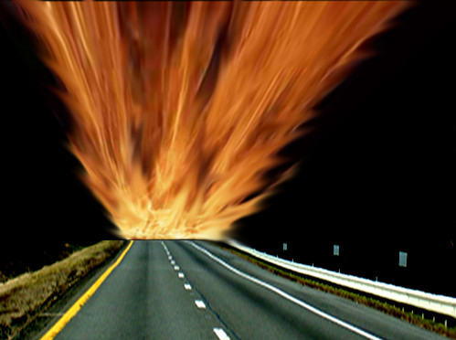
Highway To Hell

Slide 2
ARE YOU ON THE HIGHWAY TO HELL?
On Judgment Day the Lord Jesus Christ is going to separate the sheep from the goats:
”He shall separate them one from another, as a shepherd divideth his sheep from the goats." [Matthew 25:32]
The sheep (those trusting in Jesus alone for their salvation) will go with Jesus to Heaven and the goats (those trusting in their own righteousness or false gods or false religions) will be cast into Hell for all eternity to pay for their sins themselves.
So which are YOU? A sheep or a goat? How do you know?
For accurate answers to ultimate questions visit: www.comingintheclouds.org

