Slide 1
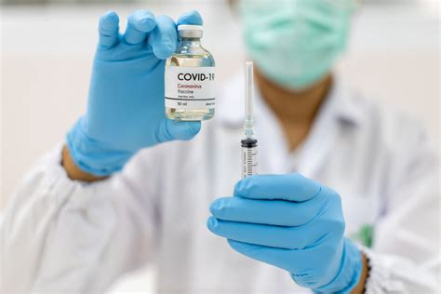
Something Worse Than COVID-19?
What Could That Possibly Be?

Slide 2
What could be worse than COVID-19? Isn’t it some terrible virus that has killed MANY people world wide? Perhaps it is… or perhaps it is no more deadly to healthy people than the common flu. That’s not the issue here. The issue is, what could be WORSE? The answer to that question is very simple: Eternity without God in eternal torment in Hell. That is where EVERYONE ends up if they die without the Lord Jesus Christ as their Savior. Its not a matter of having the right religion. Its not about being better than others and its not about having done more good deeds than bad. God won’t be comparing you to other sinners on Judgment Day. He will be comparing you to the Lord Jesus Christ, the sinless Son of God, and we all fall far short of that standard.
“But we are all as an unclean thing, and all our righteousnesses are as filthy rags.” Isaiah 64:6 “There is none righteous, no, not one” “For all have sinned, and come short of the glory of God;” Romans 3:10,23
Have you received the SPOTLESS ROBE of the righteousness of the Lord Jesus Christ or are you still wearing the FILTHY RAGS of your own self-righteousness? While there is life, there is hope. God tells us to repent or perish.
“The wicked shall be turned into hell, and all the nations that forget God.” Psalm 9:17
For accurate answers to ultimate questions visit: www.comingintheclouds.org

